Slide 1
Jpg vs. png
Matthew Bencomo
WDD230, BYU Idaho Pathways Worldwide

Slide 2
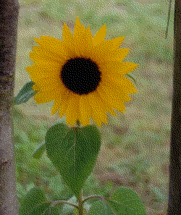
History
Needed a good compressed format for images
GIF
XMB
Replaced by PNG when GIF appeared to start charging royalty fees.

Slide 3
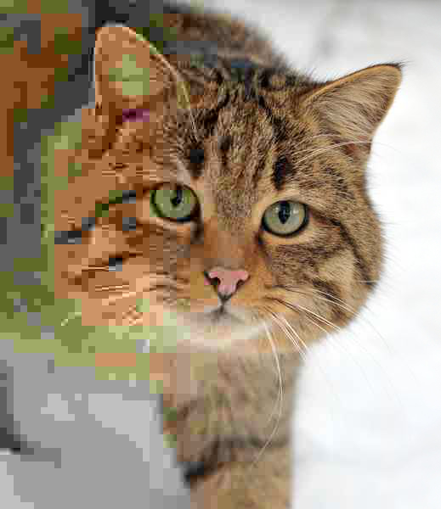
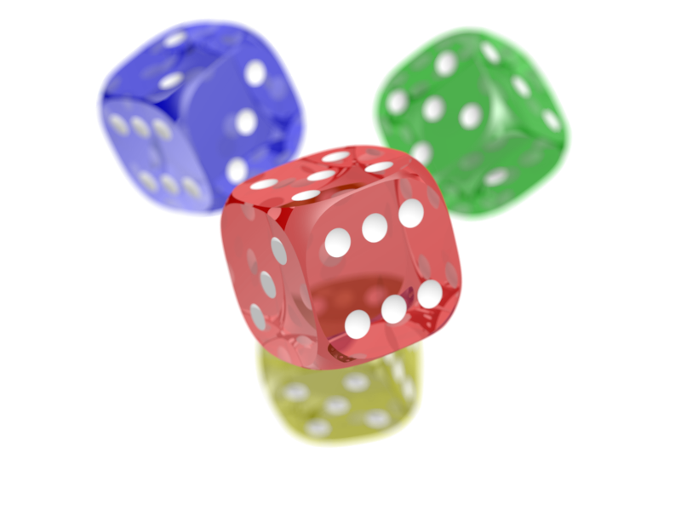
Modern Era
← JPEG
New less ‘lossy’ formats
PNG (PNG not GIF)
JPEG
PNG →

Slide 4
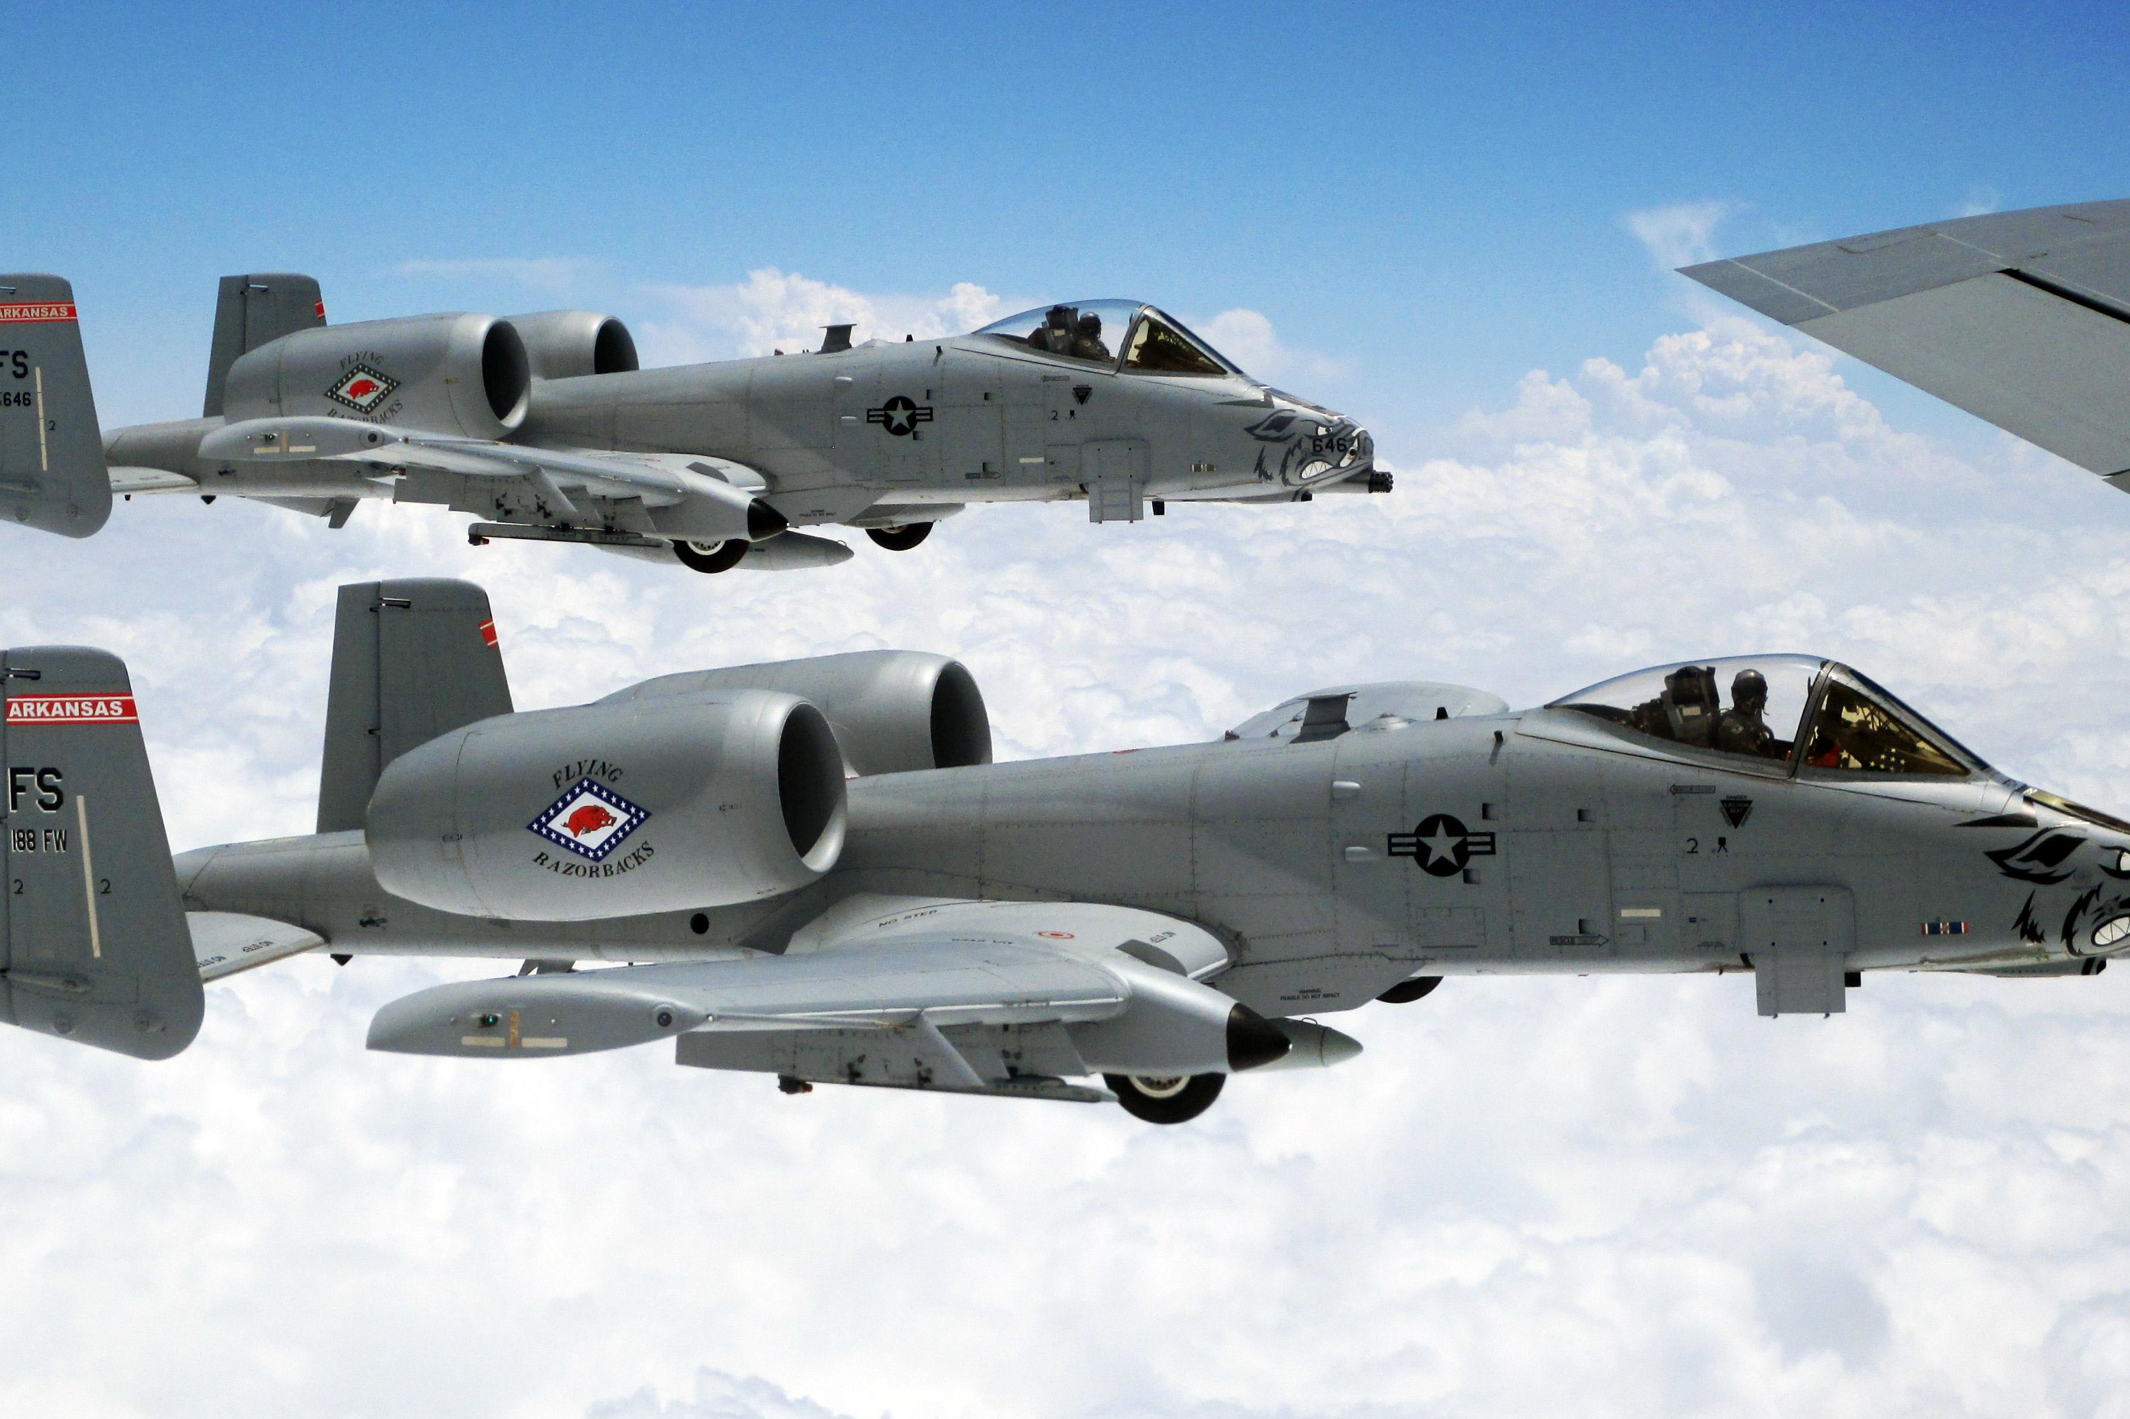
JPEG
Joint Photographic Experts Group
Lossy compression
10:1 compression ratio
.jpg/.jpeg/.jfif
Best used for photographs and images with lots of color. Does not handle sharp edges or contrast well.

Slide 5

PNG
Portable Network Graphics, PNG not GIF
Lossless compression
Supports alpha transparency
.png/.PNG
Best used for logos, icons, or small images with limited colors and/or sharp edges and contrast.

Slide 6
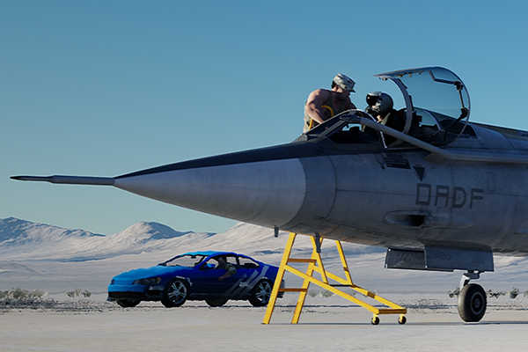
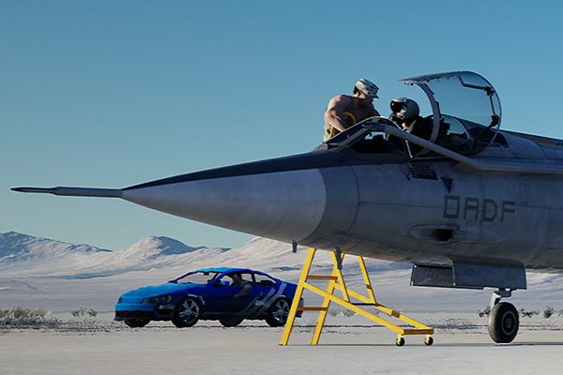
Difference in compression
JPEG
PNG

Slide 7


File Size Comparison
378KB
2.38MB

